Slide 1






FULLSTACK-PROJECT PRESENTATION

Slide 2

AMAZED WITH CUISINES
Presented By:
Aryan Reddy(201500156)
Muskan Sharma(201500420)
Ayush Sharma(201500183)

Slide 3
Supervised By: -
Mr. Akash Kumar Choudhary
Technical Trainer,
Department of Computer Engineering & Applications
GLA UNIVERSITY, MATHURA

Slide 4
OUTLINE
About the Project
Objective
Requirements
Snapshots from the website

Slide 5
ABOUT THE PROJECT
"Amazed with Cuisines" is a recipe search website that aims to provide users with an easy-to-use platform to search for recipes and explore different cuisines from around the world. The website features a vast collection of recipes ranging from traditional to modern, along with detailed instructions and images to guide users in preparing their favorite dishes.
Users can search for recipes by ingredients, meal type, cuisine, and dietary requirements. The website is designed to be user-friendly and mobile responsive, allowing users to access recipes on the go. With "Amazed with Cuisines," users can discover new and exciting recipes to try at home and share their culinary adventures with others.

Slide 6
OBJECTIVE:-
At "Amazed with cuisines", we understand the importance of respecting our users' preferences and providing them with a responsive interface that caters to their needs. Our website is designed to inspire users to explore different food cultures and cuisines, with a vast collection of recipes that can be searched based on various criteria. We aim to create a positive user experience by making it easy for users to navigate the site and find the recipes they are looking for. Additionally, we value user feedback and continuously strive to improve the site based on their needs. By putting the user first and listening to their input, we hope to build a strong relationship with our users and establish ourselves as a reliable resource for anyone looking to explore new flavors and dishes .

Slide 7
REQUIREMENTS
Software Specification Used:-
Technology Implemented : MongoDB and React
Language Used : HTML, CSS, JavaScript, Bootstrap
Development Environment : Visual Studio code
Web Browser : Chrome / Firefox / Microsoft Edge

Slide 8
Hardware Used: • Processor Required: Intel i3 • Operating System: Windows 10 onwards • RAM: 4GB • Hardware Devices: Computer System • Hard Disk: 256GB

Slide 9
THIS IS HOW OUR WEBSITE LOOKS
Hope you will like it :)

Slide 10
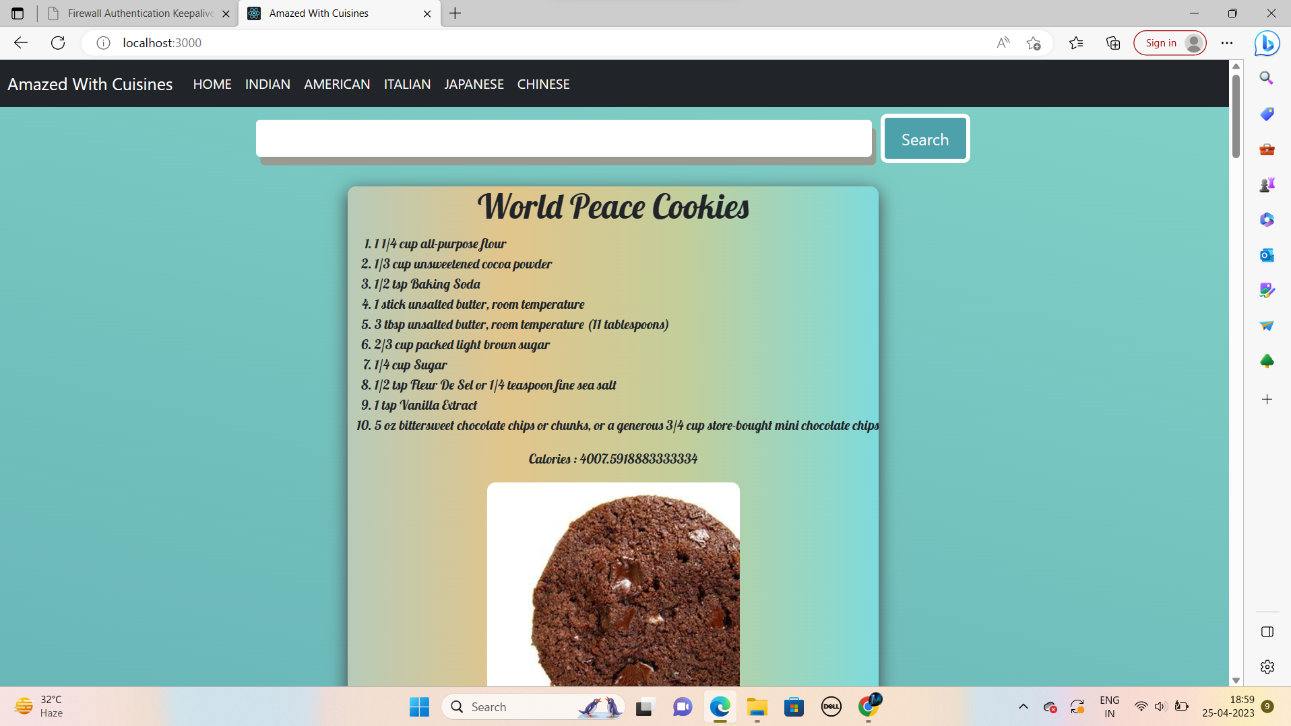
HOME PAGE

Slide 11
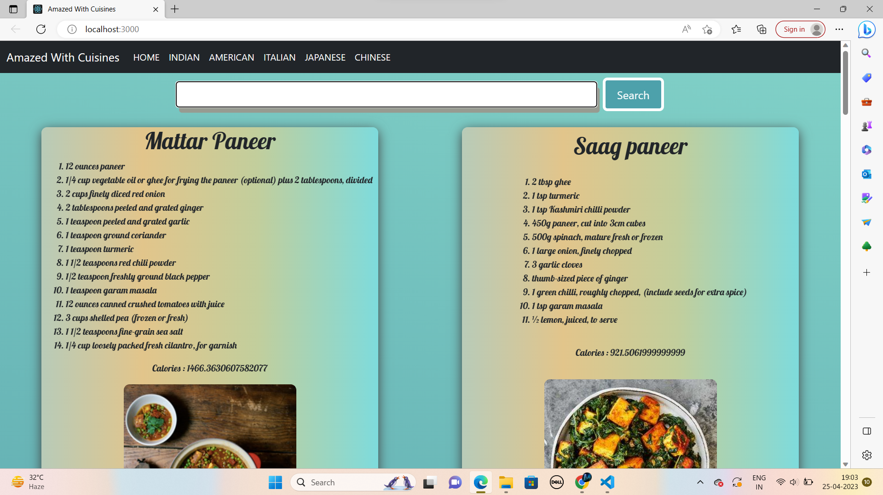
SEARCH BAR

Slide 12
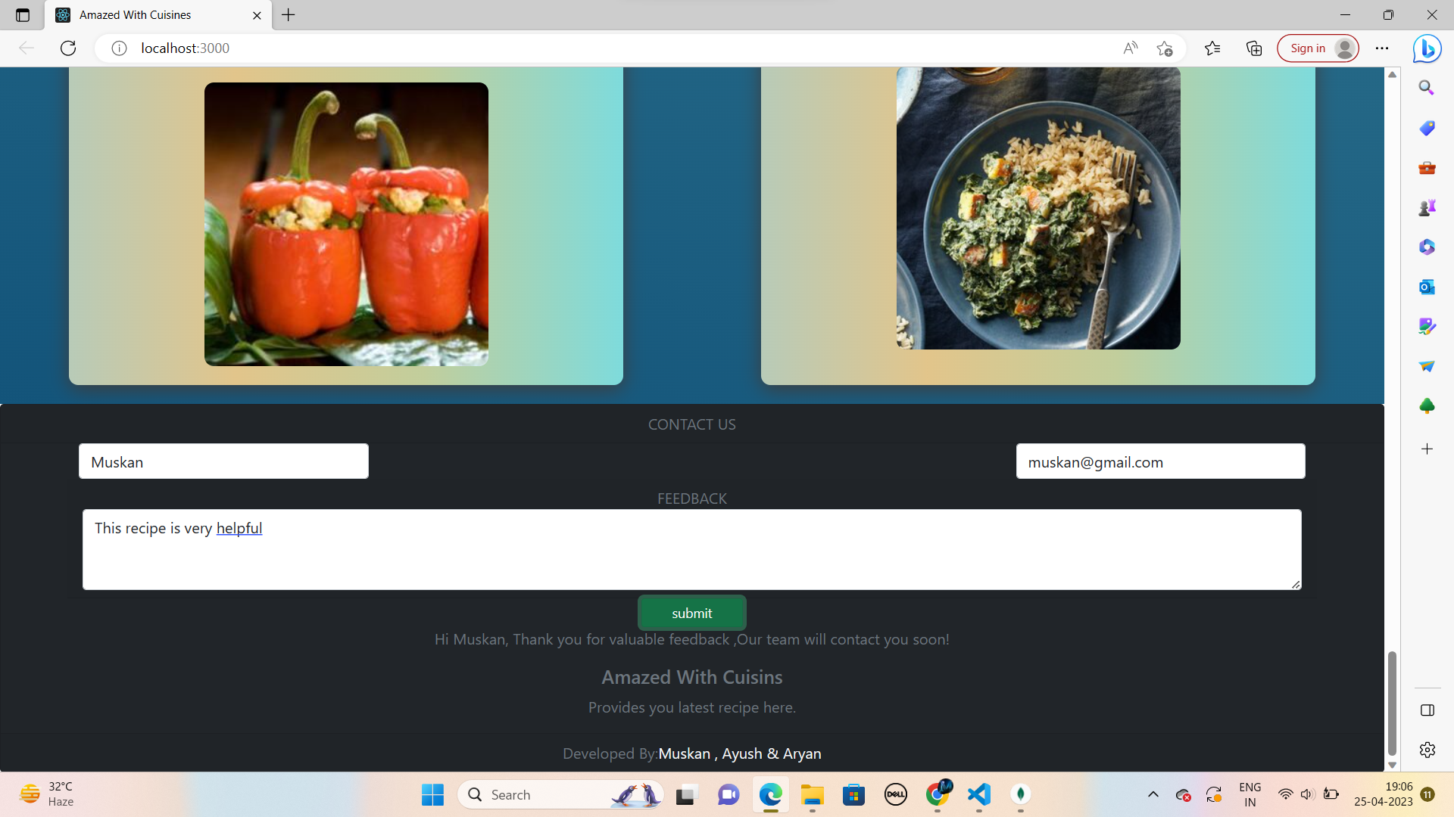
FEEDBACK FORM

Slide 13
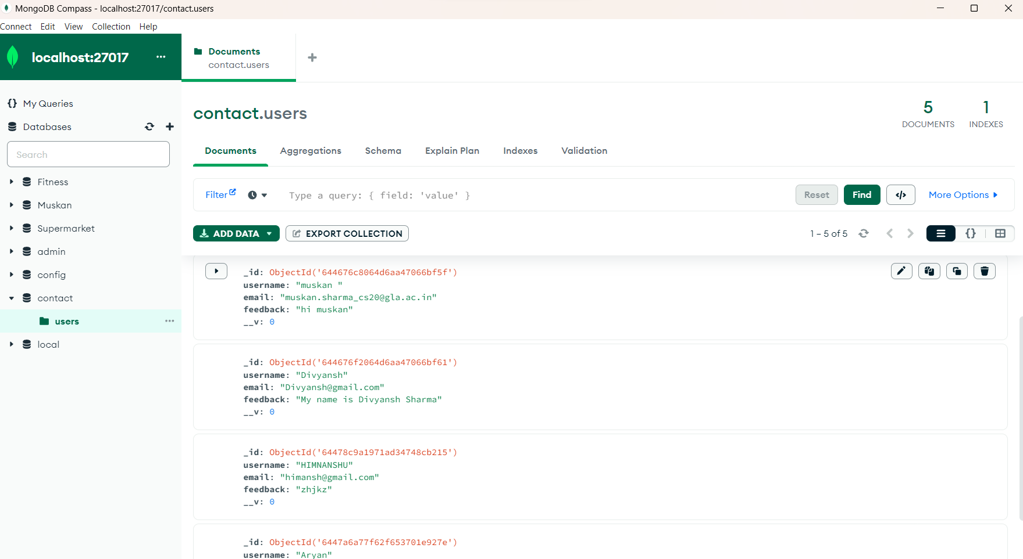
MongoDB Connection

Slide 14
Future Scope
Amazed with cuisines is a recipe search website that aims to inspire users to explore of cultures and cuisines from around the world
The website is a great resource for anyone who wants to learn more about different cuisines and experiment with new flavors in their.

Slide 15
Thank You!!!

